Slide 1
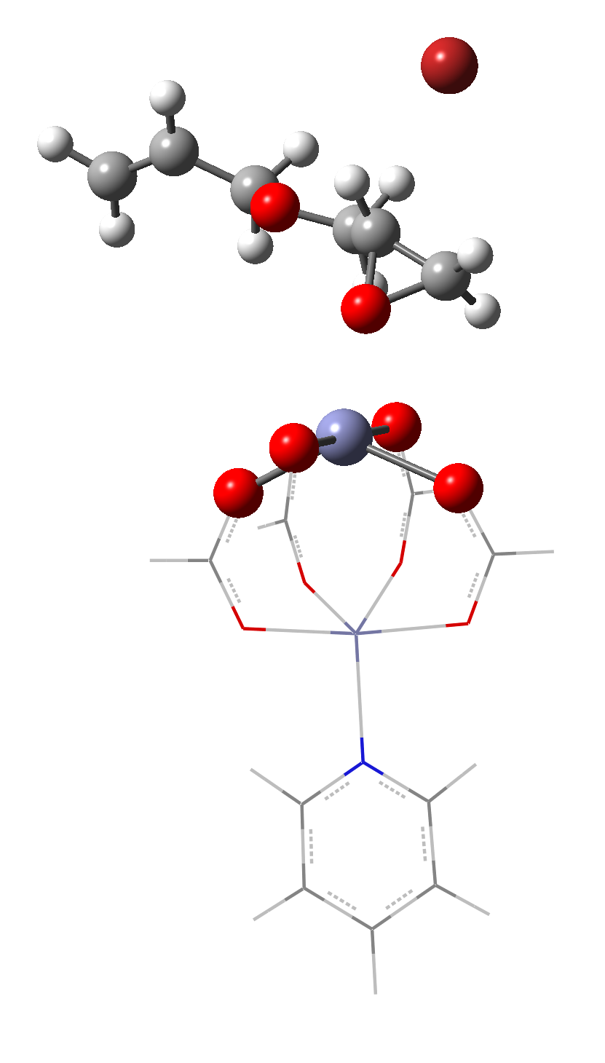
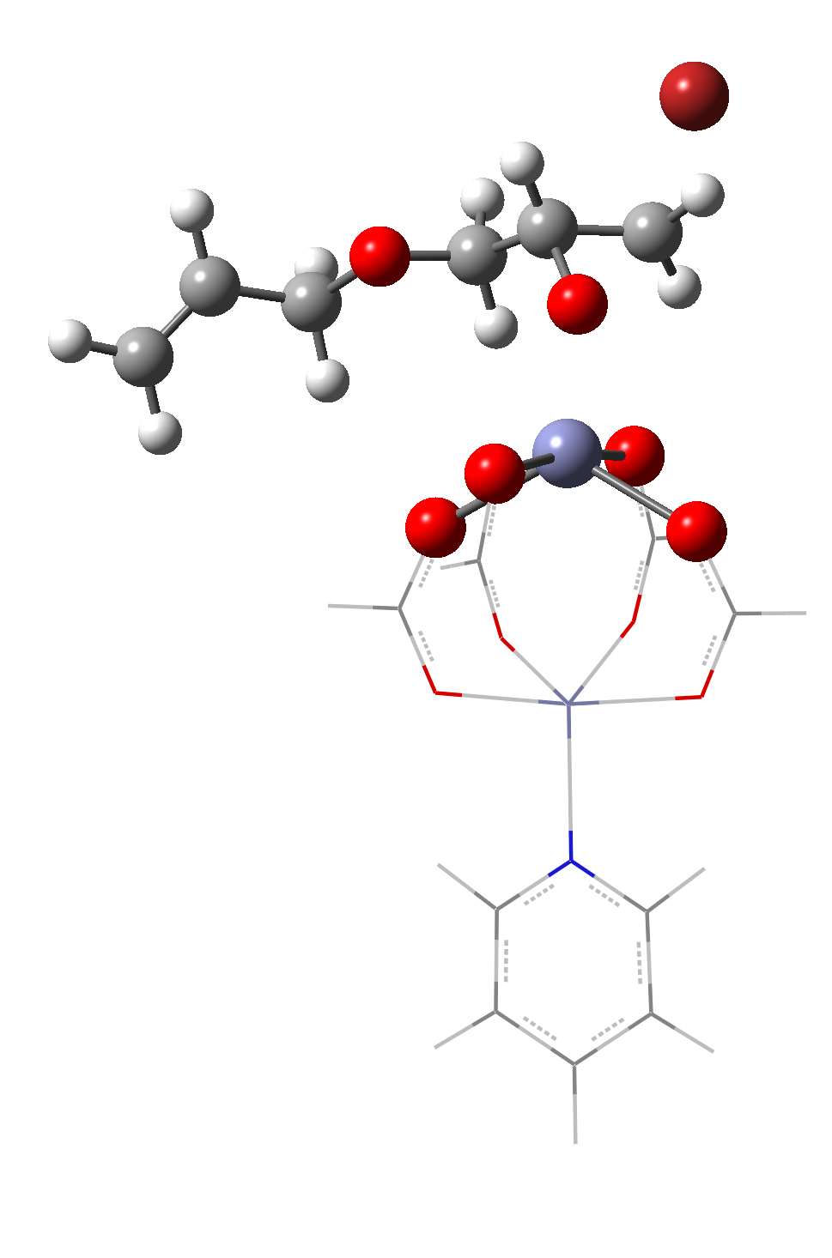
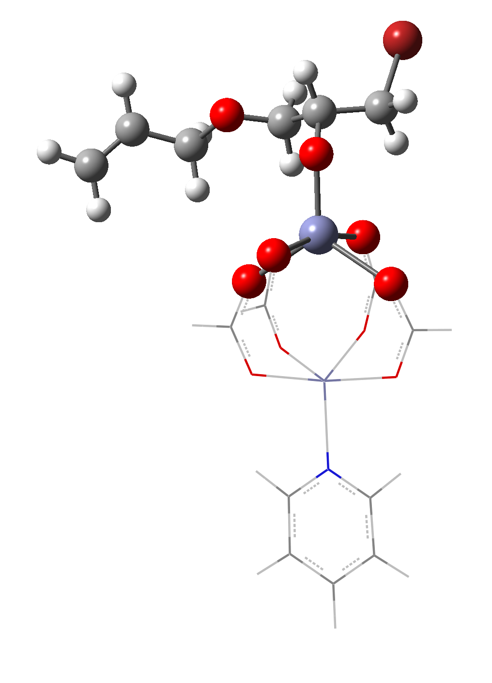
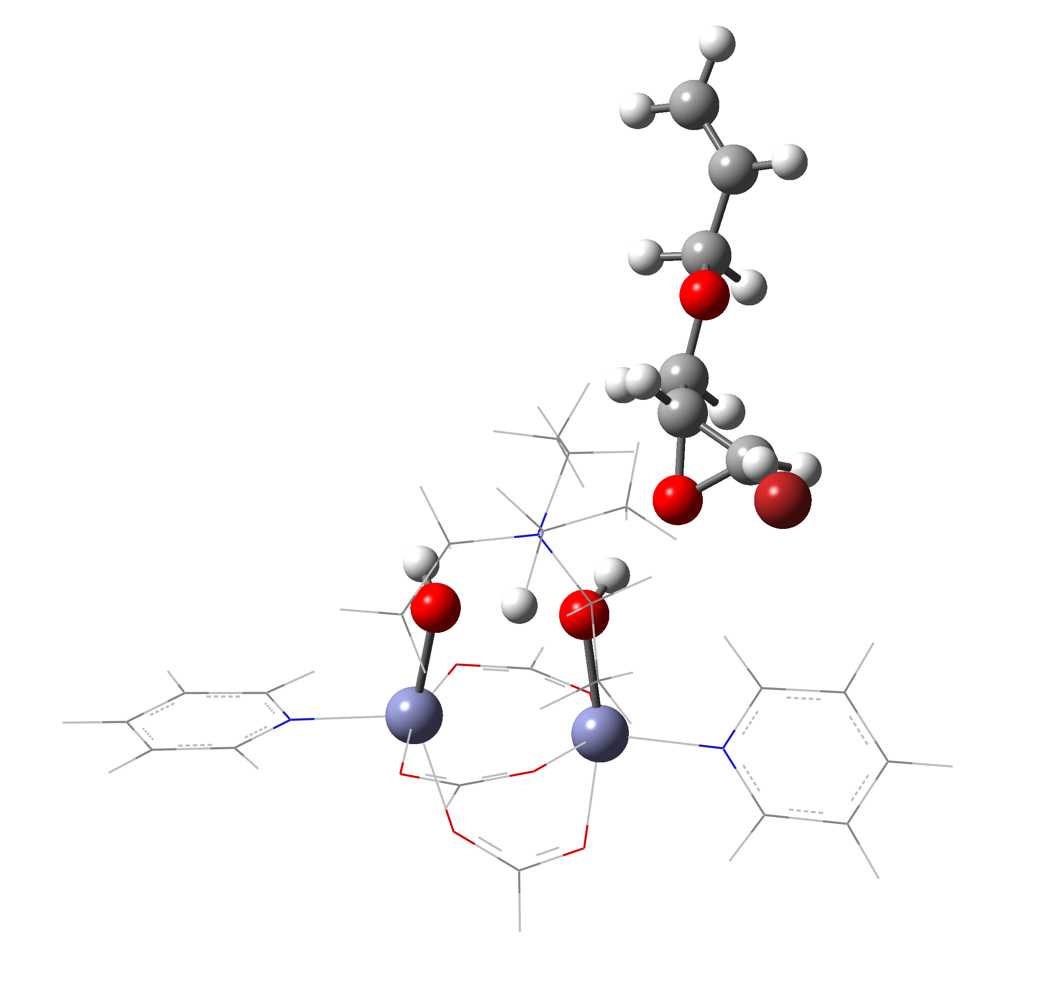
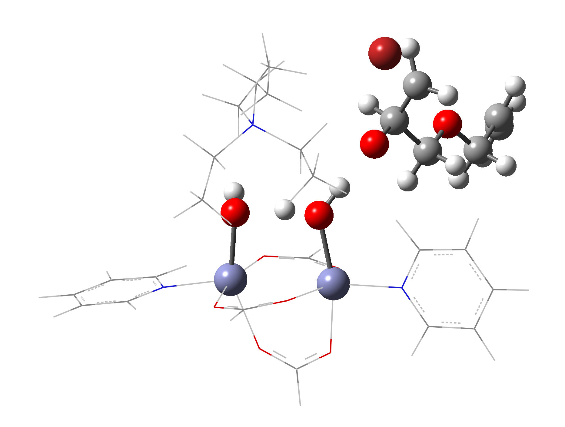
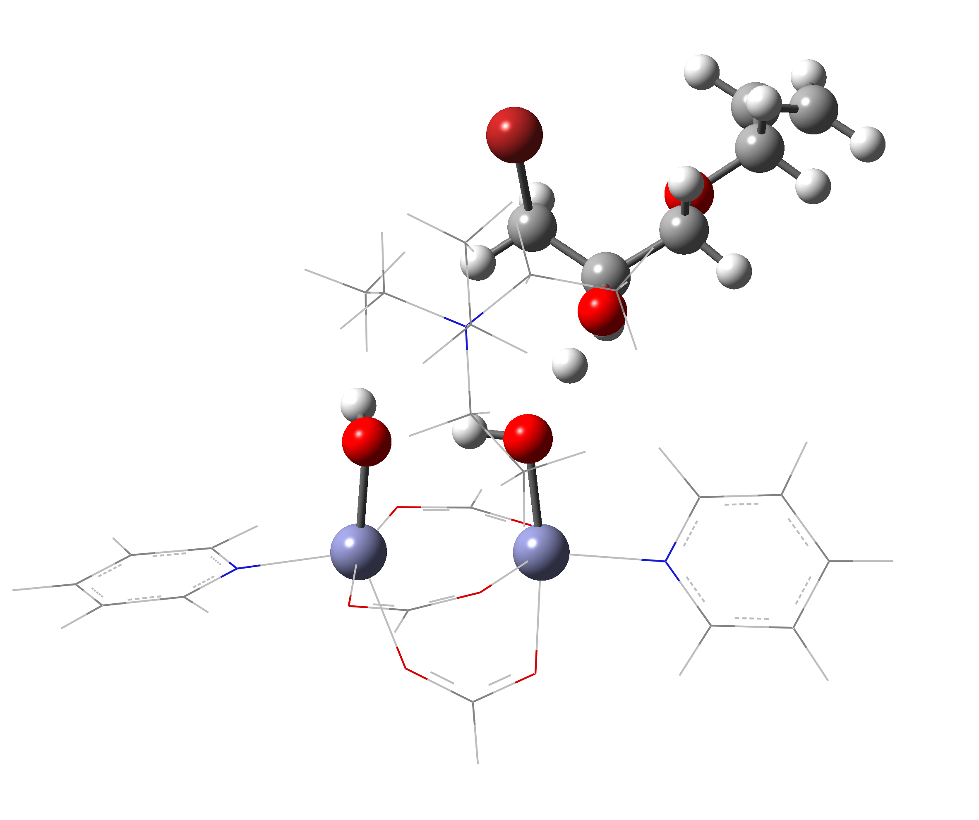




















a.
60
Open Metal Active Site
55.9
OH‒ Active Site
TS’
No Catalyst
40
21.6
20
0.0
$−$1.4
$−$1.9
0
Relative Energy (kcal/mol)
R
Int’
$−$11.8
$−$15.9
$−$12.9
$−$19.0
$−$20.5
$−$22.7
$−$20
$−$14.5
$−$25.4
P
Int₁
$−$22.9
TS
$−$23.4
$−$25.6
Int₂
Int₃
$−$28.6
$−$41.4
Int₇
$−$40
Int₄
$−$38.2
Int₅
$−$49.8
$−$60
Int₆
b.
‡
Int₂
TS
Int₃
c.
‡
Int₂
TS
Int₃

